Slide 1
Object Detection

Slide 2
What is Object Detection ?

Slide 3
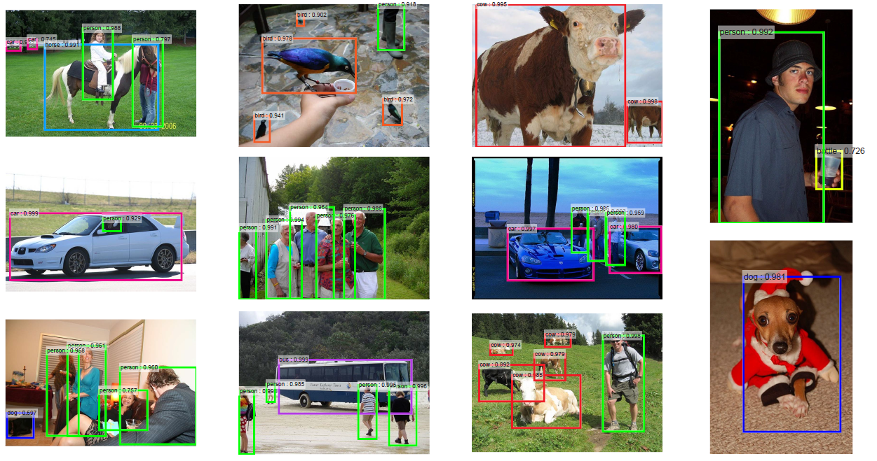
What is Object Detection ?

Slide 4

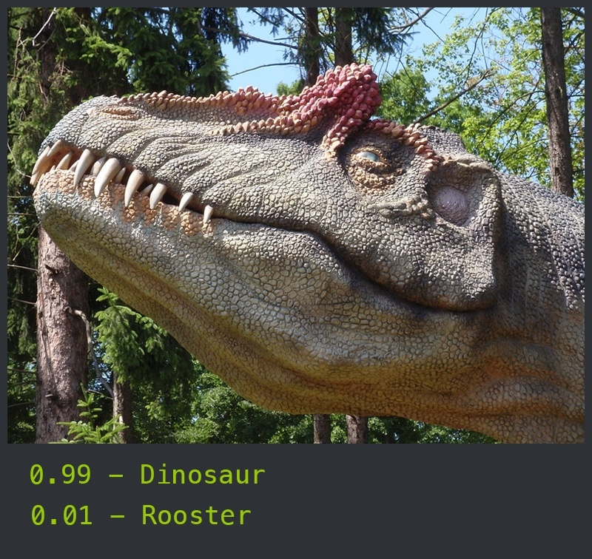
Object recognition:

Slide 5
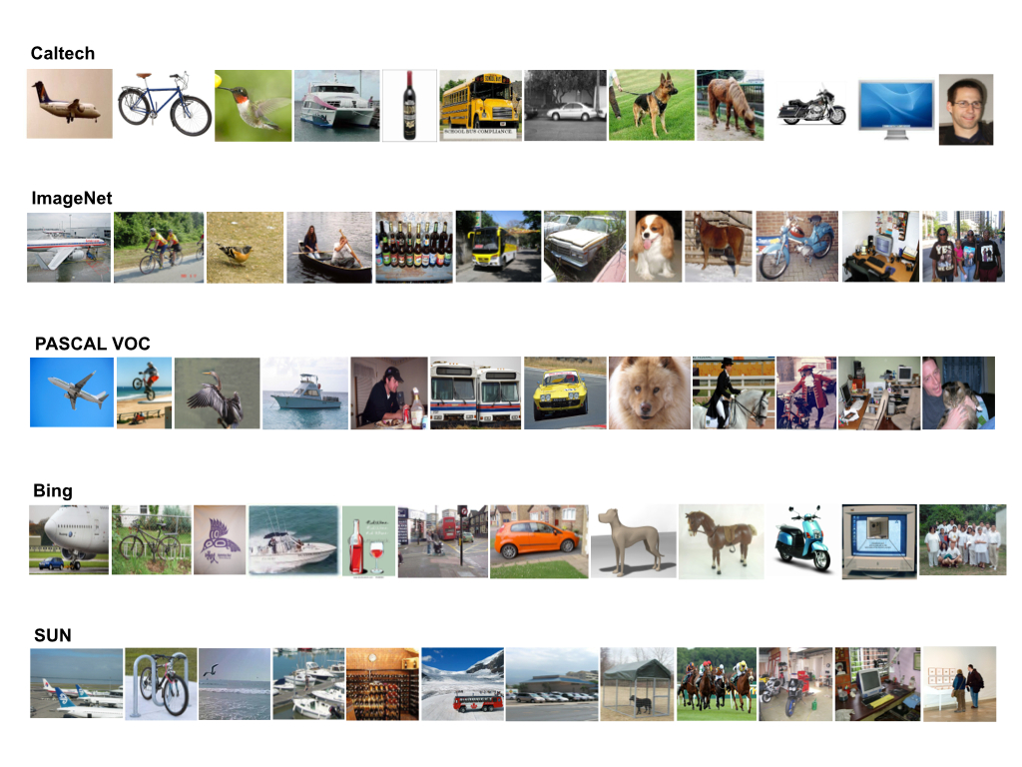
Datasets:

Slide 6
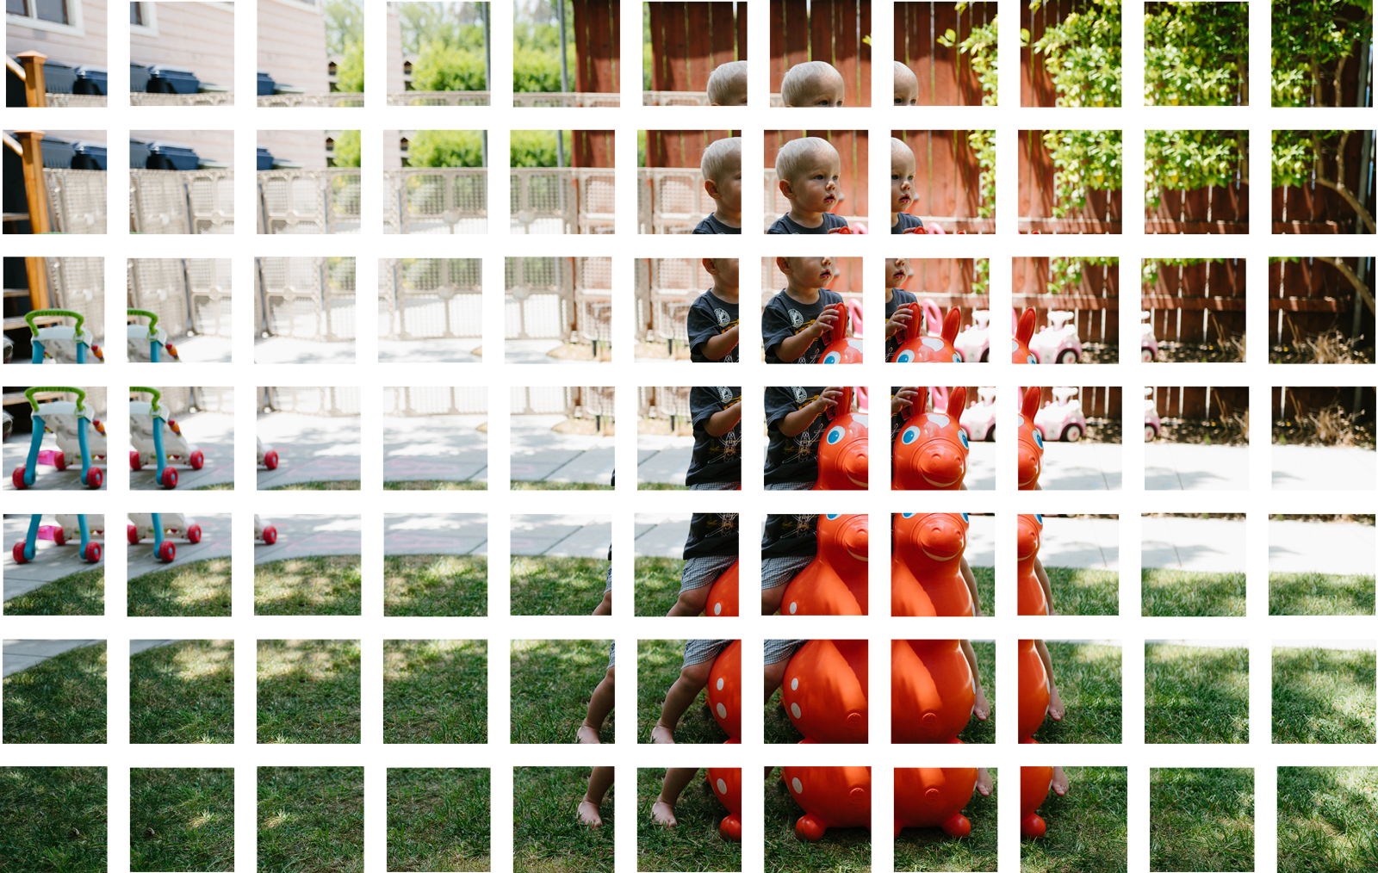
Old techniques:

Slide 7
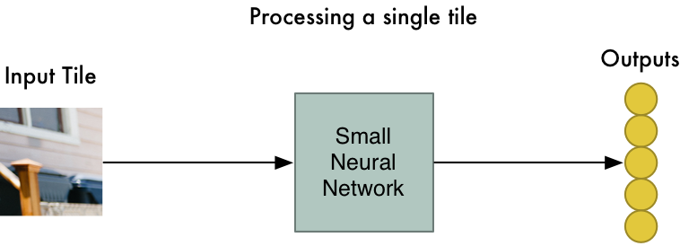
Old techniques:

Slide 8
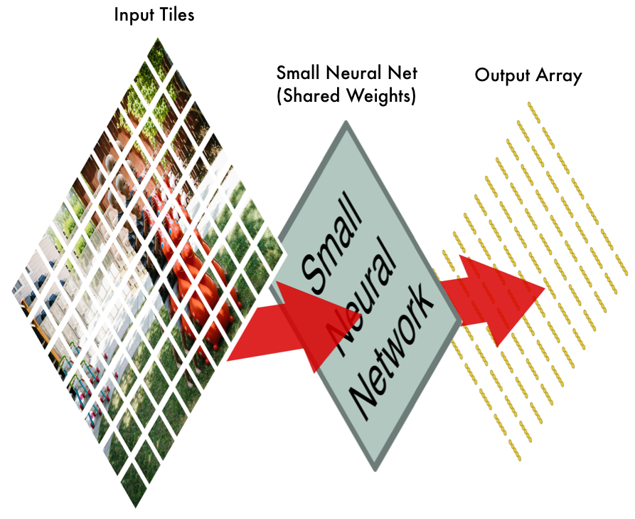
Old techniques:

Slide 9
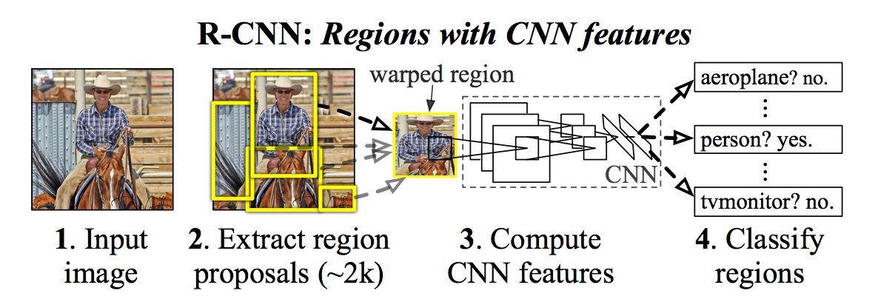
R-CNN
https://arxiv.org/pdf/1311.2524.pdf

Slide 10
R-CNN
200 classes
Selective search: window of different sizes, group similar pixels -> 2000 region proposals
Warp and AlexNet features
SVM classifier for each box
Linear regression tightens bounding box
Each model trained separately. 2000 runs of AlexNet.

Slide 11
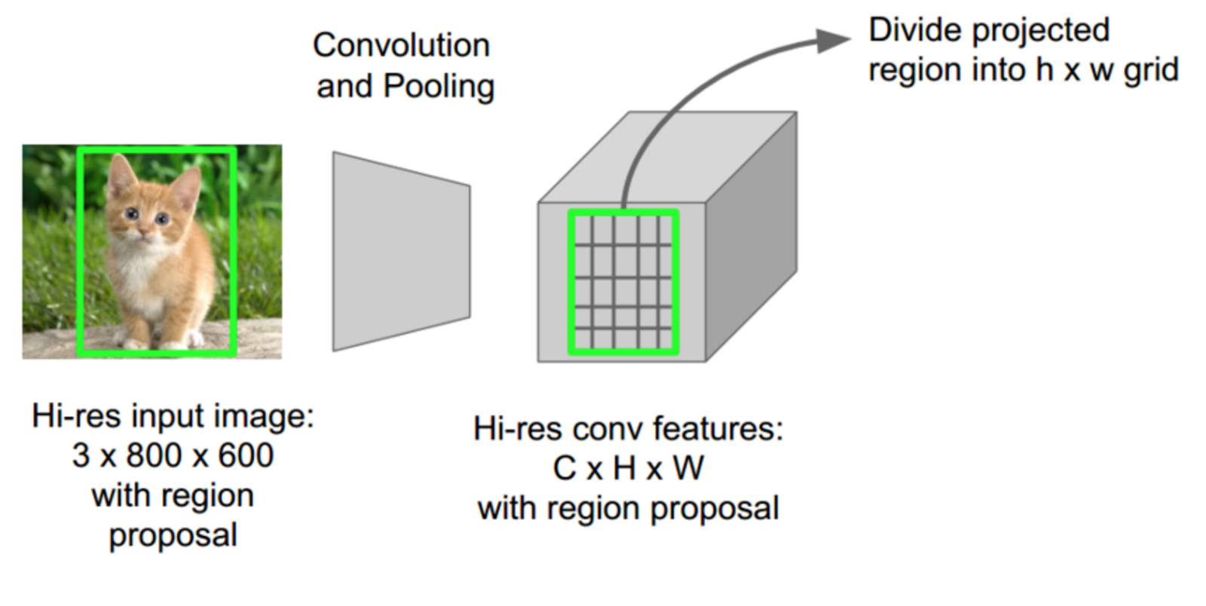
Regions of Interest Pooling Single Forward Pass

Slide 12
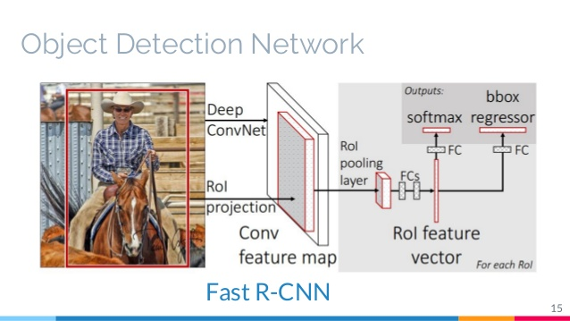

Slide 13
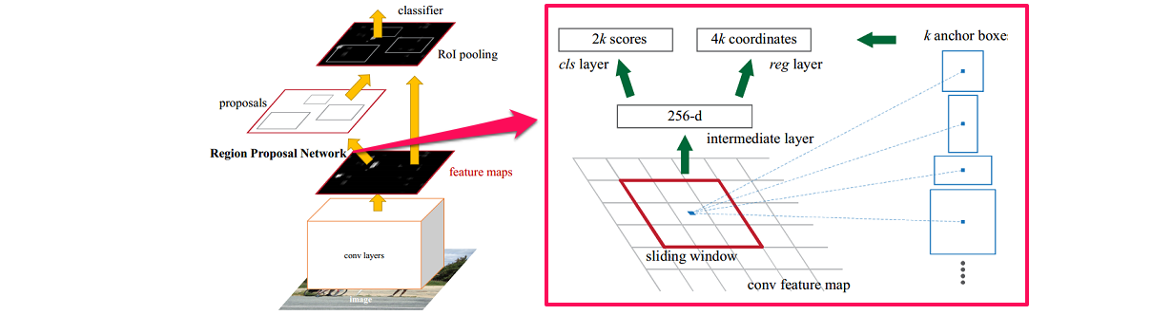
Faster R-CNN
Use NN output features for selective search instead of separate one.
Special Region proposal network
Common aspect ratios - anchor boxes

Slide 14
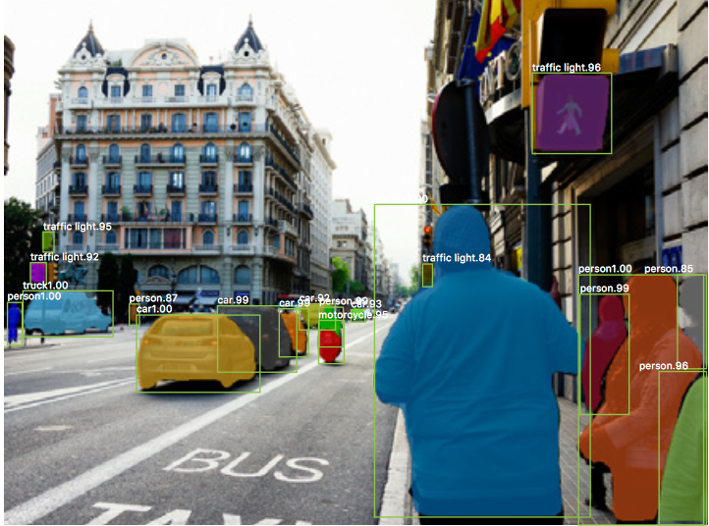
Mask R-CNN

Slide 15
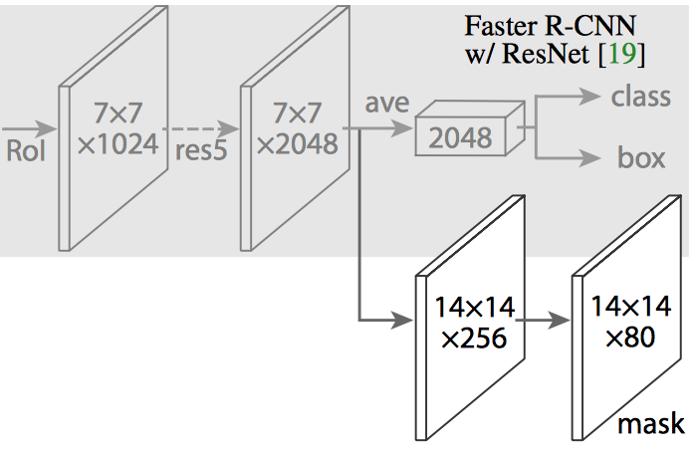

Slide 16
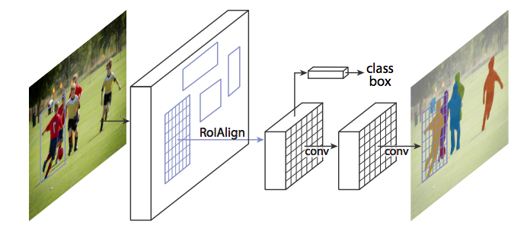

Slide 17
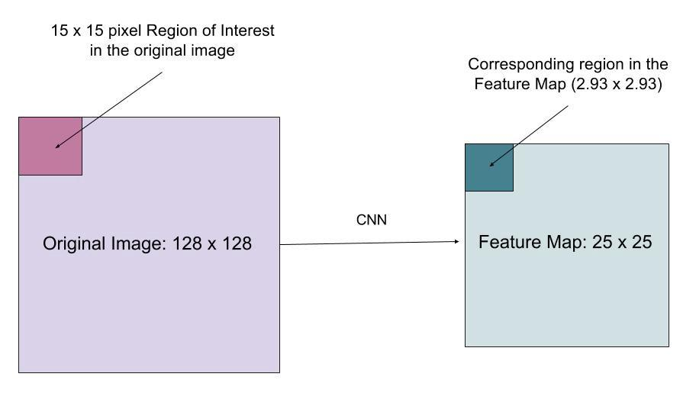
Bilinear interpolation instead of rounding to integer

Slide 18
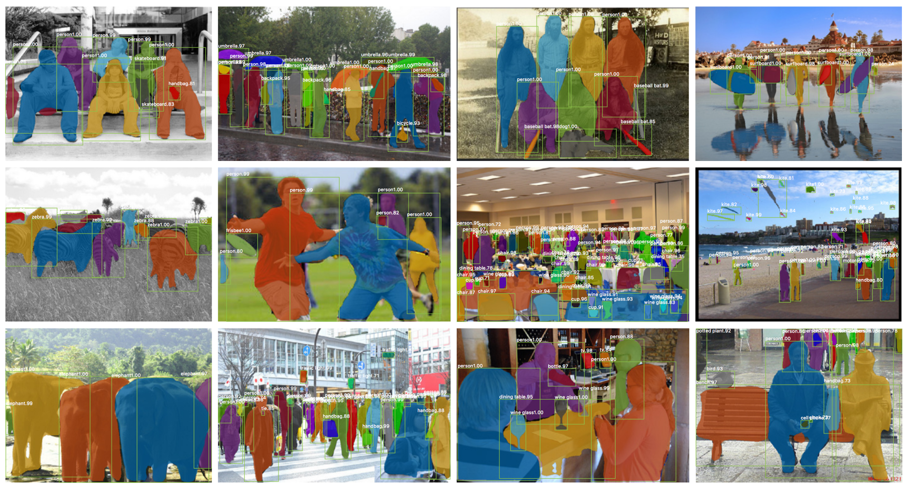

Slide 19
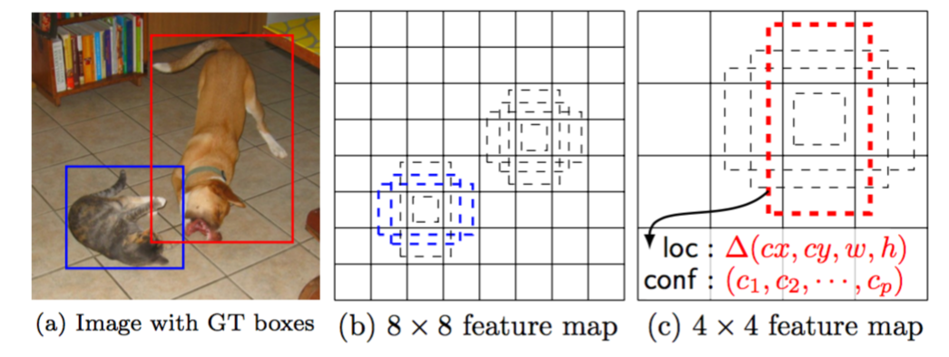
Object detection architectures: SSD

Slide 20
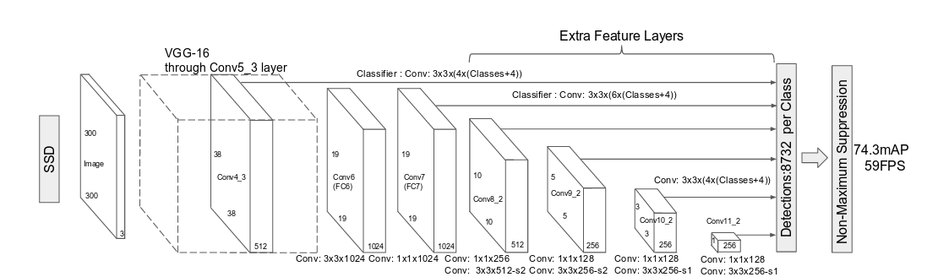
Single Shot Multibox Detector (SSD)

Slide 21
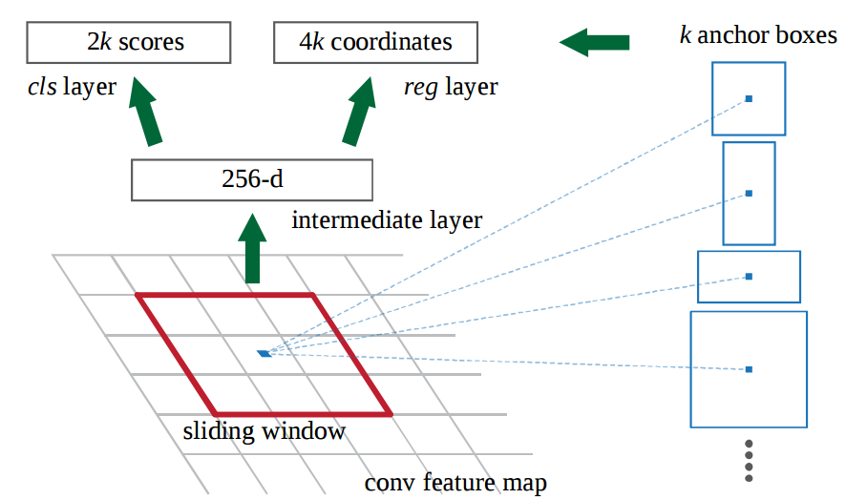
Single Shot Multibox Detector (SSD)

Slide 22
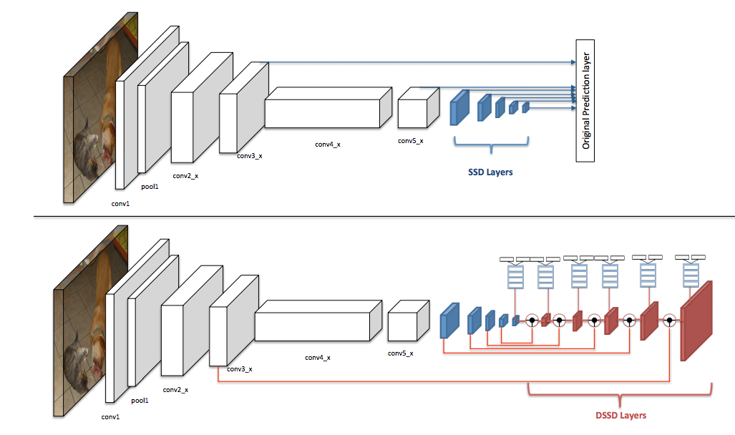
Object detection architectures: SSD, DSSD

Slide 23
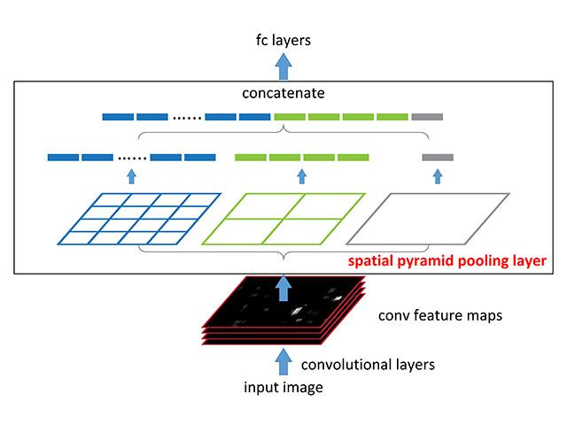
Spatial Pooling Layer

Slide 24
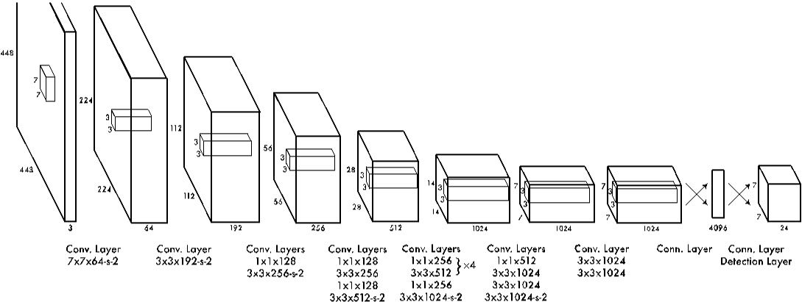
You Only Look Once (Yolo)

Slide 25
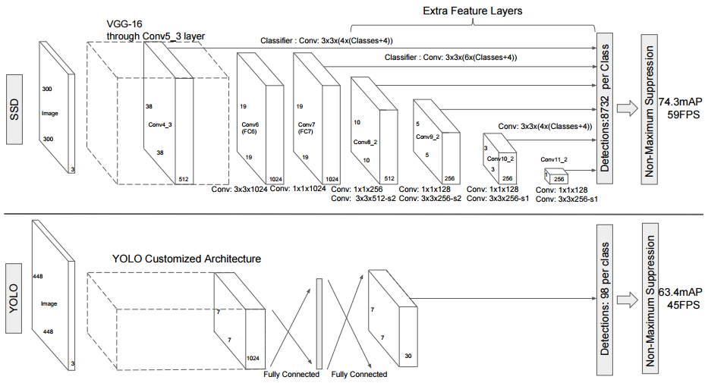

Slide 26


Slide 27
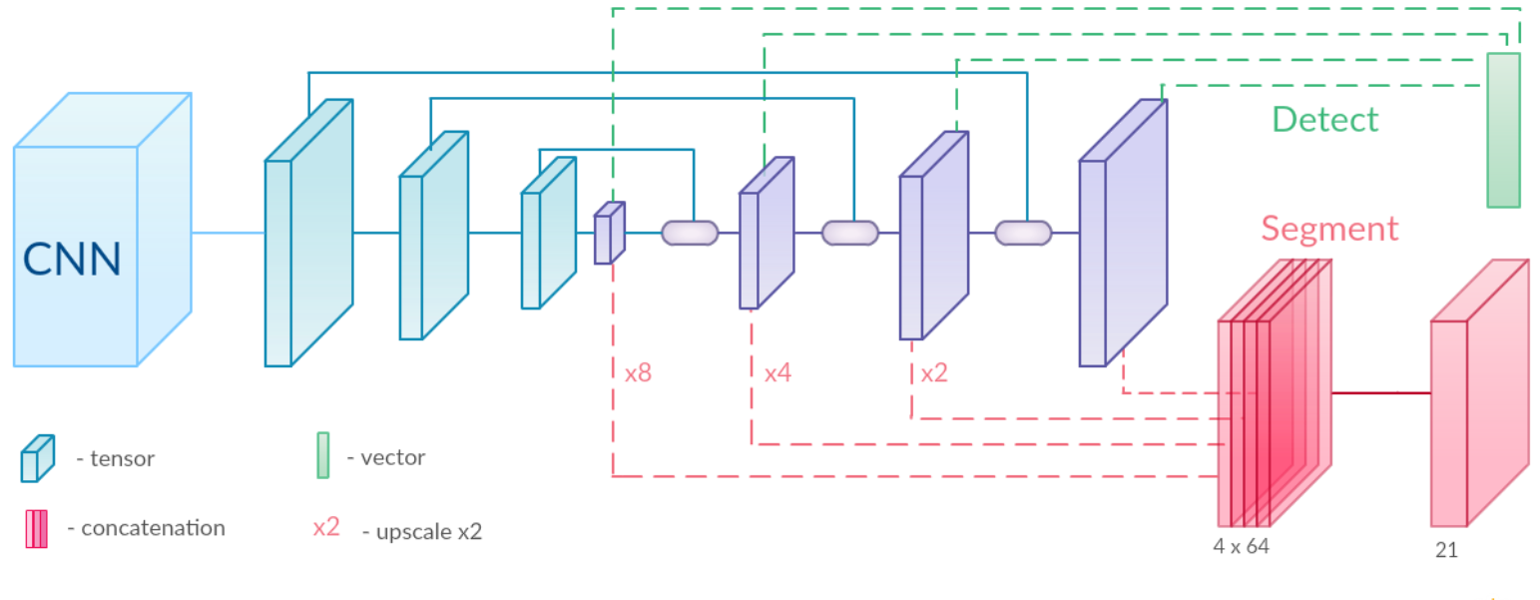
SemSeg + ObjDetection:

